Slide 1
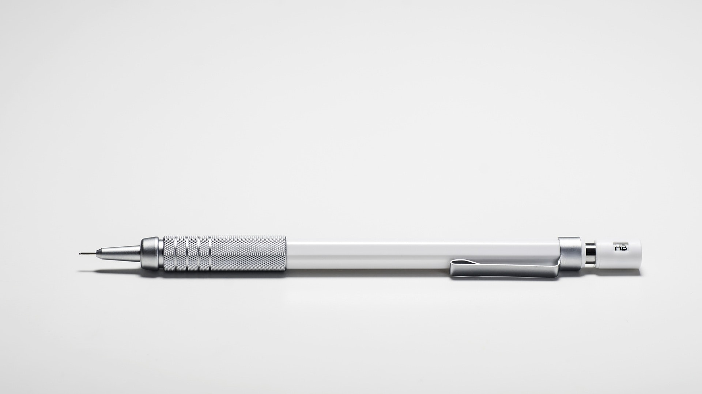
Choose Design & Technology
and make your mark…

Slide 2
The world is uncertain…
…but also looks pretty cool

Slide 4
The future will demand these skills
Deal with uncertainty
Curiosity
Openness
Entrepreneurship
Empathy
Resilience
Optimism
Imagination
Rapport and relationships
Action
Notes:
The original article is here https://www.forbes.com/sites/tracybrower/2021/02/14/the-future-of-work-will-demand-these-8-new-skills/?sh=441da54d22e6

Slide 5
"Design and Technology is logical, creative and practical, it’s the only opportunity that school students have to apply what they learn in maths and science – directly preparing them for a future in engineering.“
James Dyson

Slide 6
Universities look for D&T-related skills
Skills and attributes:
Enthusiasm for the course
Independent thought
Collaboration and teamwork
Perseverance
Notes:
Info from article https://www.ef.com/wwen/blog/efacademyblog/5-qualities-universities-look-applicants/#:~:text=Independent%20thought%20and%20study&text=University%20is%20all%20about%20scholarship,management%20and%20independent%20study%20skills.

Slide 7
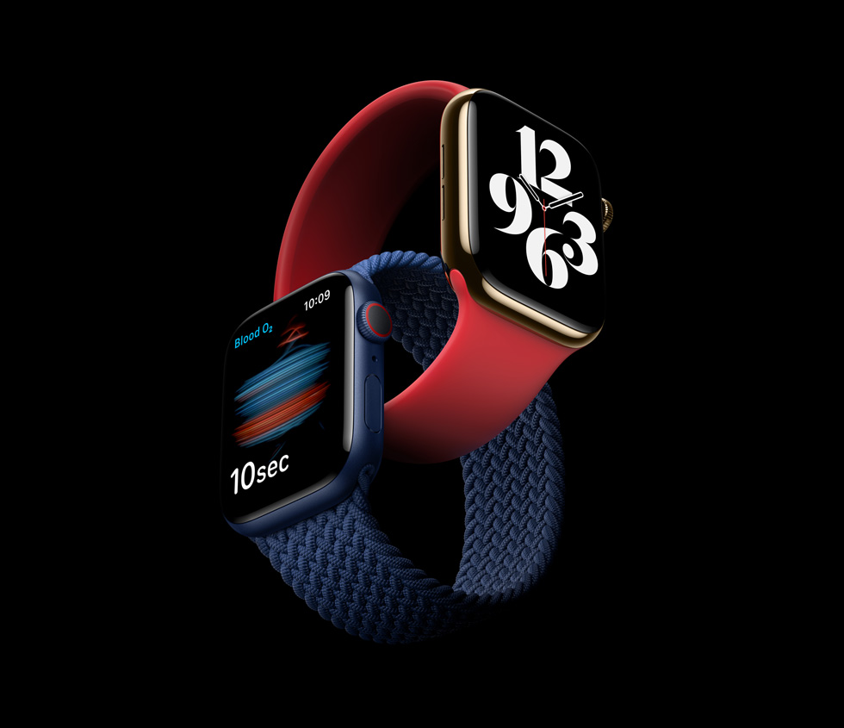
Sir Jonathan Ive, designer of many of Apple’s iconic products you have seen, used or maybe own, studied Design and Technology at school.

Slide 8
It can pay very well
Top 10 best paying graduate jobs include:
Software engineer
Software developer
Civil engineer
Design engineer
Mechanical engineer
Notes:
Info from article https://www.cityam.com/glassdoor-reveals-the-uks-top-10-best-paying-graduate-jobs/

Slide 9
“In a world which is so oversupplied, one way to succeed and stand out is to have a creative and lateral way of thinking about things. Creativity makes businesses, careers and futures for people and this is why subjects like Design and Technology are so important.”
Sir Paul Smith - Designer

Slide 10
Common myths
It’s all about making things.
The course is 50% Design & Make – this includes research, analysis, development, evaluation. However, there is equal weighting for the examination.
It’s not as important as other subjects.
Universities (and employers) recognize it as a very important subject and a very challenging one.
I have to be good at drawing and making.
Drawing helps but you can communicate your ideas other ways. Creativity and problem-solving skills are the most important alongside and relentless work ethic.
What use is it? I don’t want to go into a D&T job.
Look what universities and employers are looking for – Interchangeable skills, creativity, independence, problem solving, innovation. = DESIGN AND TECHNOLOGY!
Notes:
You may wish to add more of your own, for example, gender balance in your school?

Slide 11
“D&T was my favourite subject at school – the one time that I got to apply my creativity and problem solving skills to the creation of new products, and see my ideas become reality.”.”
Abbie Hutty– Lead Spacecraft structures engineer, ExoMars vehicle

Slide 12
Possible careers
Product designer
Industrial designer
Architect
Aerodynamicist
Automobile design
CAD/CAM operator
Engineer (civil engineer, mechanical engineer, design engineer...)
Project Manager
Fashion designer
Biomedical Engineering
Theatre/set designer
Interior designer
Computer game designer
Measurement & Control
Carpenter & Joiner
Cabinet & Furniture Making
Electrician
Also links well with careers in business, marketing and advertising.
Notes:
Obviously many more. Edit accordingly

Slide 13
Course details
Our exam board is:
What will I study?
Notes:
Add information about your D&T course here

Slide 14
In year 10
You will be expected to cover:
Etc
Notes:
Pop in what you may cover in year 10

Slide 15
In year 11
Your year looks like:
You may wish to mention the split of NEA and exam
Show examples of students’ work from previous years?
Run through how you structure lessons / units?
Mention independence, creativity, refer back to key skills required in the future
Notes:
Add notes specific to year 11

Slide 16
Video library
Clothing and accessory designer
Craft apprentice
Junior design engineer
Apprentice mechanical engineer
Senior computer games designer
Notes:
Note: These videos link to YouTube, so ensure you have access in school before attempting to play. Otherwise download and embed into the presentation.
You may wish to choose one or two and delete the others?

